Slide 1
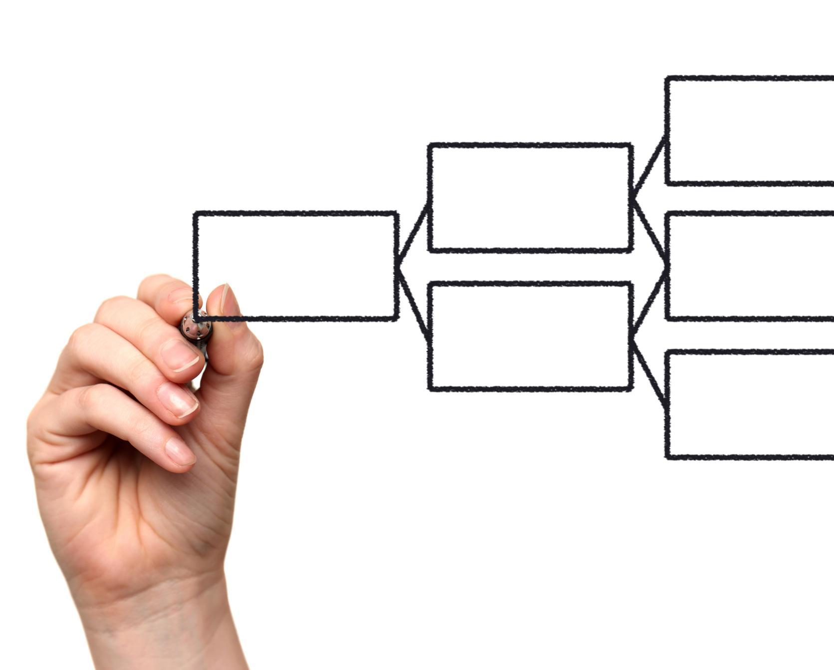
Title Page
Notes:
AI-generated content may be incorrect. --- In today's fast-paced world, technology problems can arise in various organizations. In this presentation, we will discuss a structured approach to identify and propose solutions to technology problems. By following this approach, organizations can effectively address their technology problems and attain their goals.

Slide 2

Brief Description of the Problem
<Describe the problem this project seeks to solve. Be concise and detail the effect the problem has on business.
Decreased Productivity
Employees struggle to work around the issue and cannot perform at their best.
Financial Loss
Technology problems can lead to financial loss due to missed opportunities, lost customers, and decreased revenue.
Reputation Damage
Reputation damage, as customers become frustrated with the organization's inability to provide reliable products or services.
Notes:
A brief description of the problem provides a clear understanding of the issue at hand. In this slide, we will describe the technology problem that the organization is facing.

Slide 3
Proposed Solutions
Silver Option
Gold Option
Platinum Option
Details including specs, cost and ROI
Details including specs, cost, ROI and added features
Details including specs, cost, ROI and added features
Notes:
Once the technology problem is identified, proposing solutions is the next step. In this section, we will discuss three possible solutions to the technology problem.

Slide 4
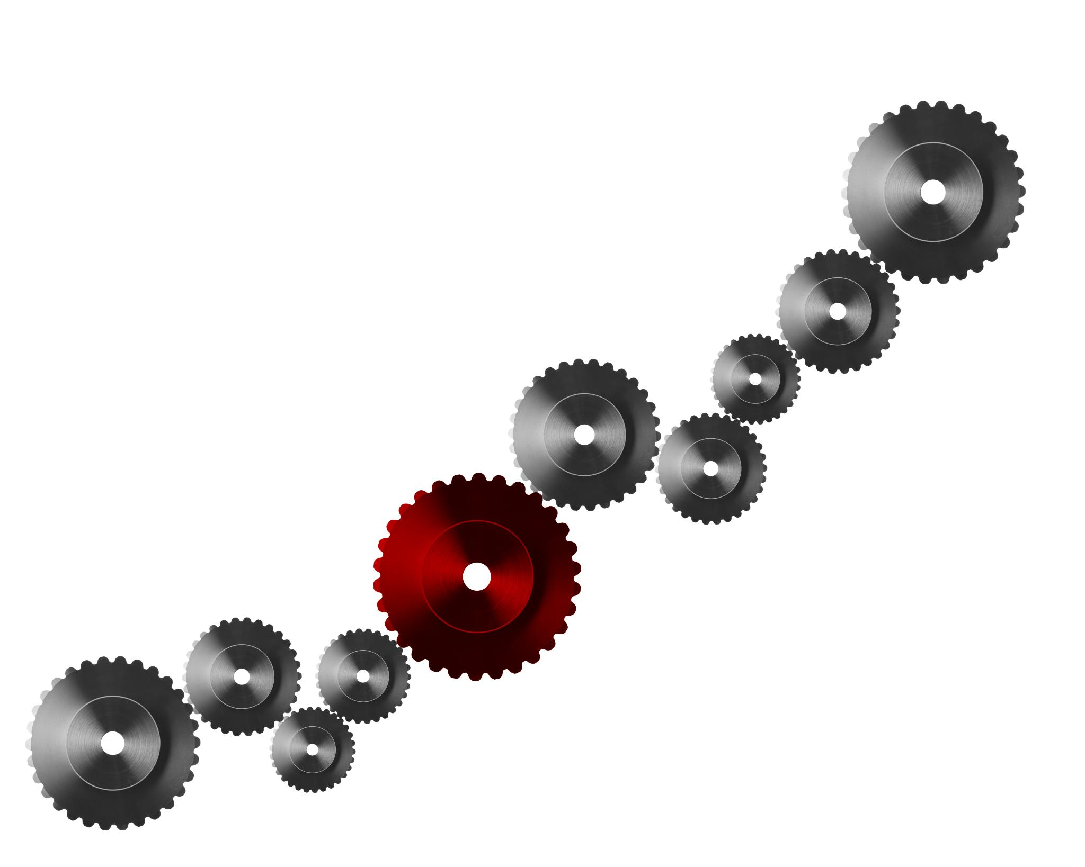
Cost of Doing Nothing
Decreased Productivity
Loss of Revenue
Outdated Infrastructure
Missed Business Opportunities
Loss of competitive advantage
Increased Risk
Notes:
Ignoring technology problems can have negative impacts on the organization, such as decreased productivity or loss of revenue. In this slide, we will describe some of the potential negative impacts of ignoring the technology problem.

Slide 5

Summary of Benefits of the Proposed Solutions
The proposed solutions will enable us to address the technology problem effectively and efficiently. The benefits include increased productivity, higher efficiency, and reduced costs.
Notes:
In this slide, we will summarize the benefits of the proposed solutions and emphasize the importance of taking action to address the technology problem.

Slide 6

Steps to Implement the Chosen Solution
Step 1
Define the problem you are trying to solve and identify the goals and objectives of the chosen solution.
Step 2
Identify the resources you have available to implement the chosen solution, including personnel, budget, and equipment.
Step 3
Create a detailed plan of action that outlines the steps required to implement the chosen solution, including timelines, milestones, and responsibilities.
Step 4
Execute the plan and monitor progress closely to ensure that milestones are met and issues are addressed quickly.
Notes:
In this slide, we will provide a step-by-step guide to implementing the chosen solution, to make the process as smooth as possible.

